Slide 1



Scan to Explore
Company Website: www.varroc.com
To Share Ideas, click here

Slide 2






There is a Way To Do it Better – Find It!
Download Eureka Mobile App
Access from your phone/desktop
https://unstop.com/p/eureka-challenge-20-varroc-900669
Register Yourself
Log in and subscribe to the challenges.
Give in your creative ideas to the problem statements
Brainstorm and find solution on challenges.
Chance to Meet Varroc Leadership team
Present your idea in big platform
Preplacement offer to shortlist students
Opportunity to work in Core Product development company

Slide 3
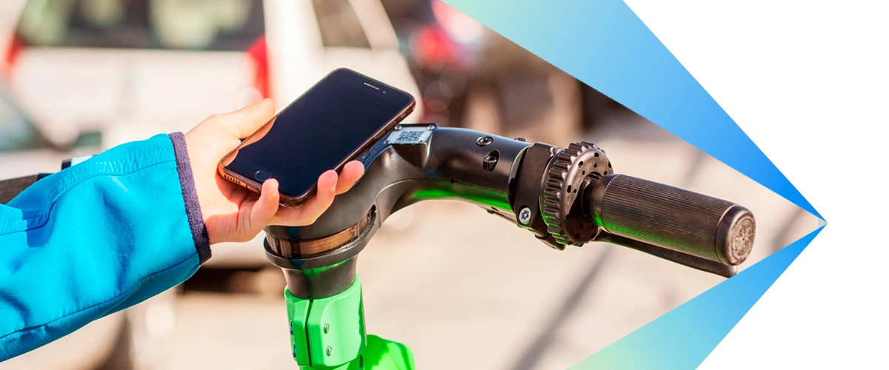
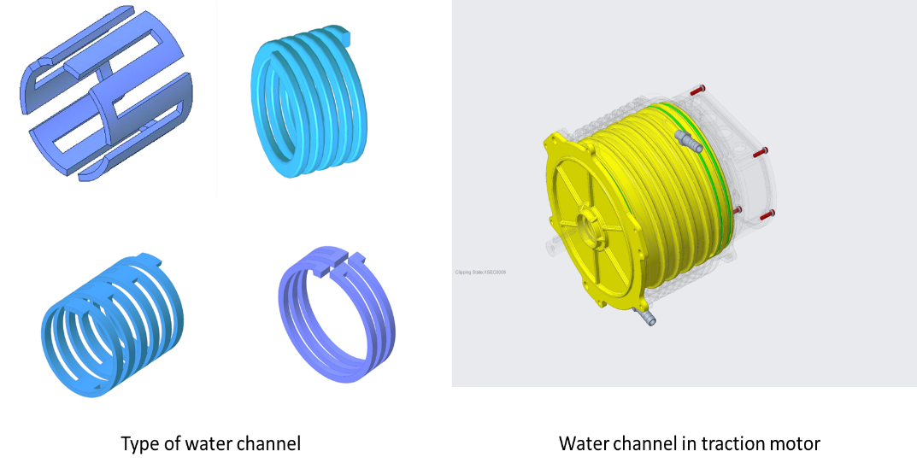
Problem Statements
Description : Design a solution to access a device/vehicle using Ultra White Band communication technology via a smartphone.
Scope: Develop a Proto to demonstrate the functionality by unlocking the device/vehicle within 10cm range.
1. Design an application of Digital key using Ultra White Band (UWB)
Description :
Design a Liquid Motor Cooling Mechanism that is manufacturing friendly and cost effective. Basic Specification:
1. Heat generated = 720W
2. Min Fluid inlet temp = 25C
3. Max Fluid outlet temp = 75 C
4. Max allowable temp of Motor Surface = 80 C
5. Dimension/ Max Space Available = Hollow cylinder with L=114 mm , ID = 171 mm , OD = 195 mm. Heat generated is along the inner wall of the hollow cylinder.
Scope: Architecture for liquid cooling along with motor enclosure; material to be used (enclosure and fluid), manufacturing process; calculations for channel design, flow rate, for pressure drop; analysis of temperature behaviour for a given channel design, fluid chosen and flow rate.
2. . Design of Liquid Motor Cooling Mechanism

Slide 4
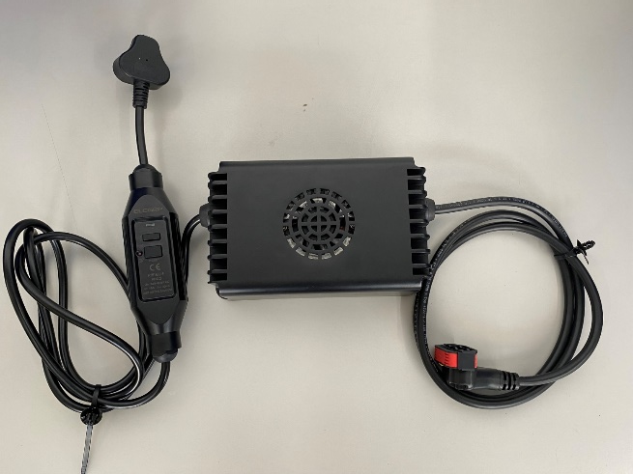
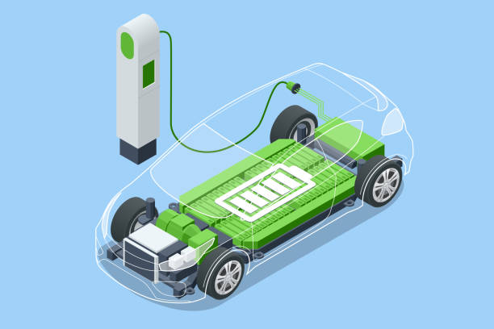
Problem Statements
Description :
1. Input rating - Nominal 230V AC. Max 300V AC - Single Phase
2. Output rating - 60V, 15Amp max
3. Efficiency > 90%,
4. Max operating ambient temperature: 50 deg C
5. Volumetric power density of box > 0.92 W/cc, No dimension (L,W or H) bigger than 180 mm, Only forced air cooling allowed, Sealed enclosure required (IP66)
Scope:
Circuit design, component selection, PCB layout, mechanical design with packaging and cooling, prototype with test data to prove performance and volumetric power density
3. Design of compact Battery Charger
Description :
Use open-source battery testing data. Come up with an algorithm to estimate remaining useful life of the battery.
Evaluation parameters:
1. Accuracy of prediction : >95% of actual capacity, Less than 20 cycles or 5% deviation for Cycle number prediction.
2. Computation efficiency of the algorithm. The model shall be deployable on edge computing devices like micro controller (Example - TIC2000, Infineon Tricore, Renesas RH850 etc)
Scope:
Working python script, Result data and plots: Cycle number Vs Capacity (Ah), Actual Capacity (Ah) Vs Predicted Capacity (Ah)
4. Estimate the remaining useful life of Lithium Ion Battery

Slide 5
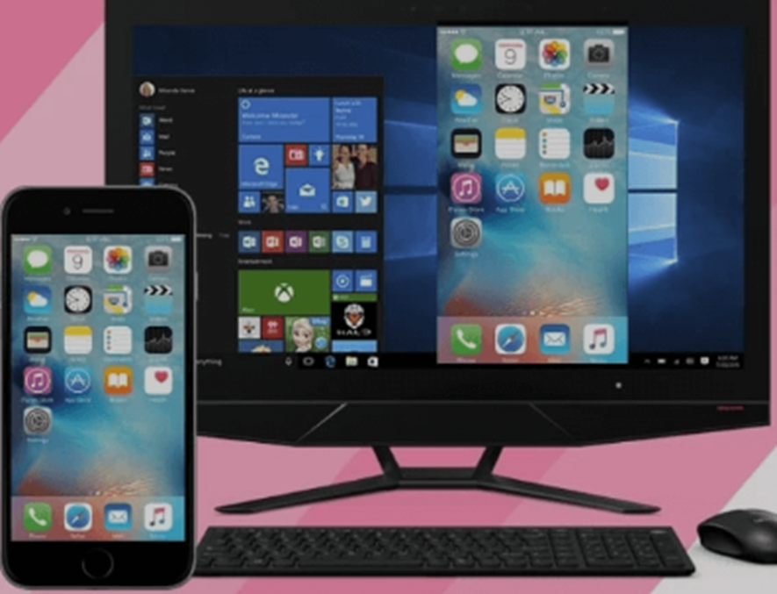
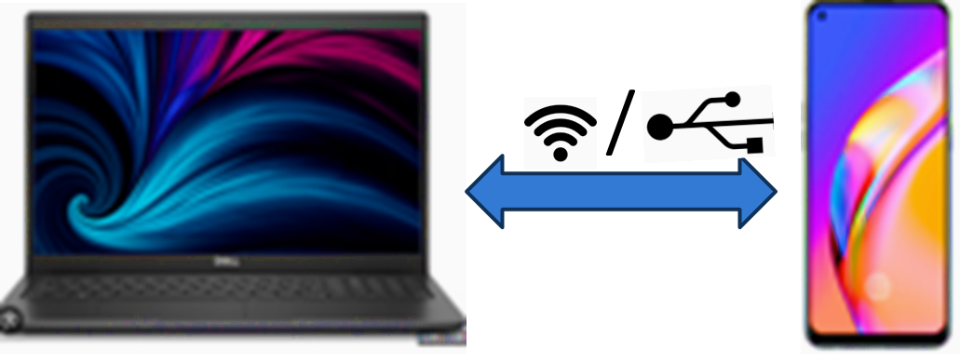
Problem Statements
Description : For Cluster Automation testing of features like Screen Mirroring, Navigation, Music and Call functionality, the mobile screen should be projected on the PC/Laptop. The PC should be able to control mobile . The connection between PC and Mobile can be through USB or WiFi.
Scope: Mobile operation control. Mobile screen projection on PC. Backend software using python to capture and process images. Define & execute basic test cases to test above mentioned features automatically.
5. Remote control of Mobile Screen Projection and Control on PC / Laptop

Slide 6
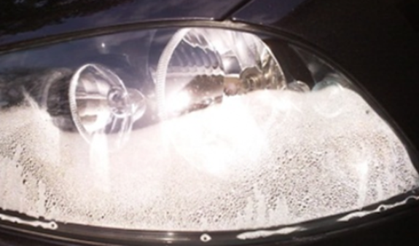
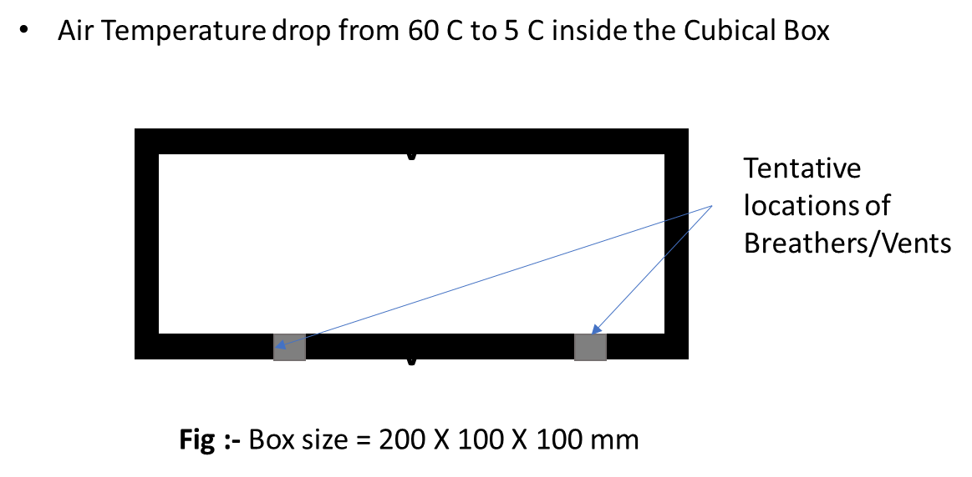
Problem Statements
Description : For given problem, define type and number of vents/breathers for removing condensate formed due to sudden drop in outside temperature. Assume suitable equations/ properties and refer heat transfer books.
Scope: Excel sheet based formula to quickly decide on condensate formed and breather/vent selection
6. Moisture removal from closed box

Slide 7

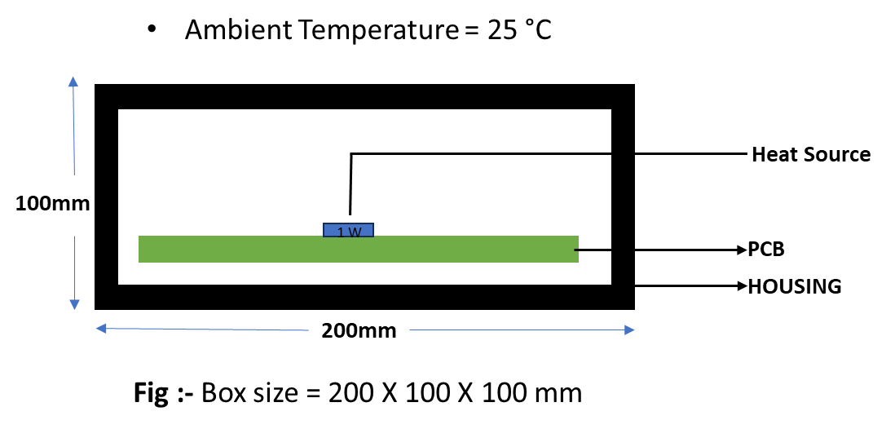
Problem Statements
Description : Based on given problem , individuals need to develop theoretical calculator for temperature prediction of heat source. Assume suitable properties if required.
Scope: For given problem, individuals should be able to predict temperature with quick empirical relation. You can refer heat transfer books and basic heat transfer equations.
7. Temperature Calculator
PARTS | MATERIAL | THERMAL CONDUCTIVITY (W/m- K ) | DENSITY ( ρ ) (kg/m3) | SPECIFIC HEAT CAPACITY (J/kg⋅K)
PCB | FR4 | 0.25 | 1850 | 1150
HOUSING | PC | 3.11 | 1125 | 1710
PCB Size = 150 X 50 X 1.4 mm
Heat Source Size = 2 X 2 X 1 mm

Slide 8
Team Name :
Team members Names | Engineering Specialisation | Graduating year | College Names
Confidential

Slide 9
Tell Us Bit About Yourself
 | [Member 1 name] | [Member 2 Name] | [Member 3 Name]
Any projects you’ve worked on
Past Hackathon experiences
Accolades or awards that you have received
Other details (If any)

Slide 10
Your Selected Problem Statements
Give us an overview of your solution
Process Flow (if applicable)

Slide 11
Design Details
Market Research and Literature survey
Flow chart/ block diagrams
Details with Pictures, Videos of simulations, calculation etc.
Working Principle
Simulations/Proto sample
Innovation/improvement over existing solution

Slide 12
Major Risk And Mitigation
Risks to realise the concept
Mitigation

Slide 13
Business Potential
Share details of Business Potential
Market Potential/Demand

Slide 14
Plan And Budget Needed
Major Milestones and Timelines to realize the concept
Budget needed to develop a prototype of this concept

Slide 15





Thank you
SELF DISCIPLINE
SINCERITY
HUMILITY
INTEGRITY
PASSION
TO SPEAK
& ACT
FROM
THE HEART
TO WALK WITH
EVERYONE
TO DO
WHAT
IS RIGHT
TO GO THE
DISTANCE
AGAINST
ALL ODDS
TO MAKE
IT HAPPEN

